Slide 1
Virtual Clusters and Resource Management
Physical versus Virtual Clusters
Live VM Migration Steps and Performance Effects
Migration of Memory, Files, and Network Resources
Dynamic Deployment of Virtual Clusters

Slide 2
Virtual Clusters and Resource Management
A physical cluster
- a collection of servers (physical machines)
- interconnected by a physical network such as a LAN.
When a traditional VM is initialized, the administrator needs to manually write configuration information or specify the configuration sources.
When more VMs join a network, an inefficient configuration always causes problems with overloading or underutilization.
Amazon’s Elastic Compute Cloud (EC2) - good example of a web service that provides elastic computing power in a cloud.
EC2 permits customers to create VMs & to manage user accounts over the time of their use.

Slide 3
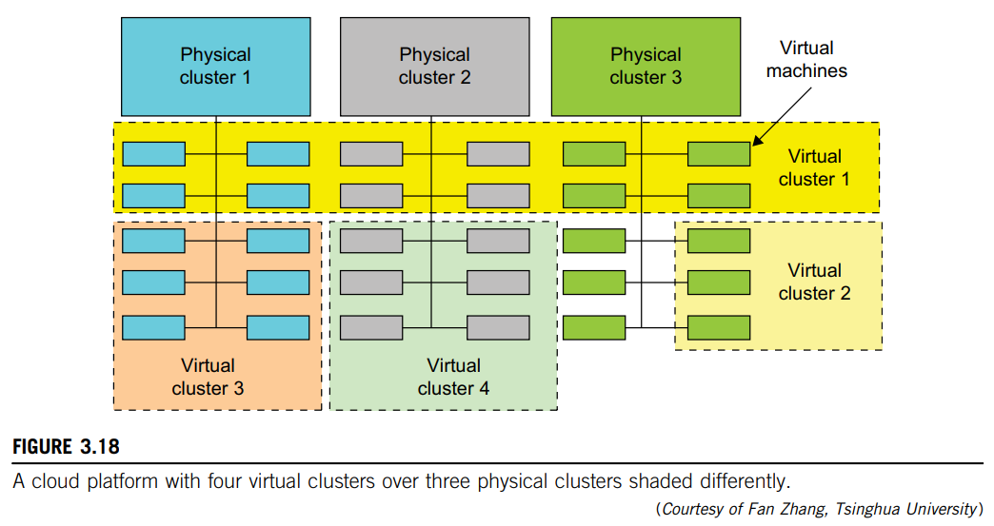
Physical versus Virtual Clusters
Each virtual cluster is formed with physical machines or a VM hosted by multiple physical clusters.
VMs in a virtual cluster - interconnected logically by a virtual network (across several physical networks).
Figure 3.18 illustrates the concepts of virtual clusters and physical clusters.
The host and guest systems may run with different operating systems.
The boundary of a virtual cluster can change as VM nodes are added, removed, or migrated dynamically over time.

Slide 4
The provisioning of VMs to a virtual cluster is done dynamically:
Virtual cluster nodes can be either physical or virtual machines
(Multiple VMs with different OSes can be deployed on same physical node).
A VM runs with a guest OS, which is often different from the host OS
(manages resources on physical machine, where VM is implemented).
Purpose of using VMs is to consolidate multiple functionalities on same server.
(will greatly enhance server utilization and application flexibility).
VMs can be colonized (replicated) in multiple servers
(for promoting distributed parallelism, fault tolerance & disaster recovery).
Size (number of nodes) of a virtual cluster can grow or shrink dynamically,
The failure of any physical nodes may disable some VMs installed
But the failure of VMs will not pull down the host system.

Slide 5
Figure 3.19 shows the concept of a virtual cluster based on application partitioning or customization.
The different colors in the figure represent the nodes in different virtual clusters.
As a large number of VM images might be present, most important thing is to determine how to store those images in system efficiently.
There are common installations for most users or applications, such as operating systems or user-level programming libraries.
These software packages can be preinstalled as templates (called template VMs).
With these templates, users can build their own software stacks.
New OS instances can be copied from the template VM.

Slide 6
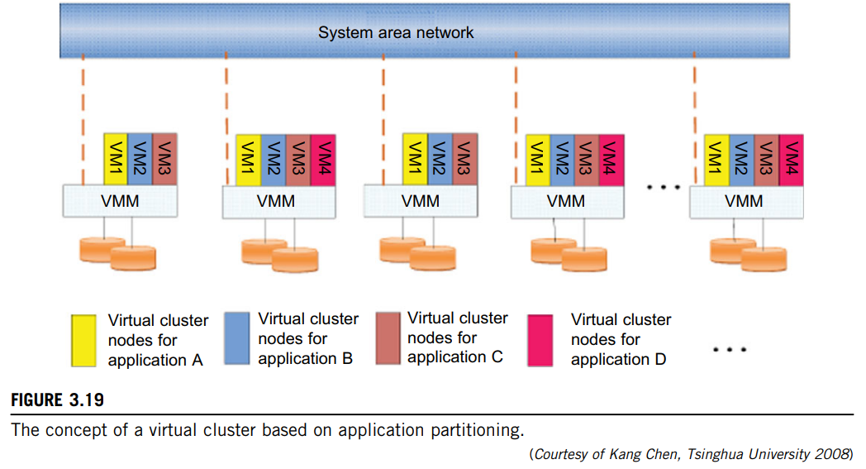

Slide 7
Fast Deployment and Effective Scheduling:
The system should have the capability of fast deployment.
Here, deployment means two things:
1. To construct & distribute software stacks (OS, libraries, applications) to a physical node inside clusters as fast as possible, and
2. To quickly switch runtime environments from one user’s virtual cluster to another user’s virtual cluster.
If one user finishes using his system, corresponding virtual cluster should shut down or suspend quickly to save resources to run other VMs for other users.
The concept of “green computing” has attracted much attention recently.
However, previous approaches have focused on saving the energy cost of components in a single workstation without a global vision.
The live migration of VMs allows workloads of one node to transfer to another node.
Therefore, challenge is to determine how to design migration strategies to implement green computing without influencing the performance of clusters.

Slide 8
High-Performance Virtual Storage:
The template VM can be distributed to several physical hosts in the cluster to customize the VMs.
Users have their own profiles which store the identification of the data blocks for corresponding VMs in a user-specific virtual cluster.
New blocks are created when users modify the corresponding data & identified in the users’ profiles.
Basically, there are four steps to deploy a group of VMs onto a target cluster:
1. preparing the disk image,
2. configuring the VMs,
3. choosing the destination nodes, and
4. executing the VM deployment command on every host.

Slide 9
Many systems use templates to simplify the disk image preparation process.
Users choose a proper template according to their requirements and make a duplicate of it as their own disk image.
Templates could implement the COW (Copy on Write) format.
A new COW backup file is very small and easy to create and transfer. Therefore, it definitely reduces disk space consumption.
Also, VM deployment time is much shorter than that of copying the whole raw image file .
However, this method is inefficient when managing a large group of VMs.
In this scenario, the system configures the VMs according to the chosen profile.
A strategy to choose the proper destination host for any VM is needed.
The deployment principle is to fulfill the VM requirement and to balance workloads among the whole host network.

Slide 10
Live VM Migration Steps and Performance Effects
In a cluster built with mixed nodes of host and guest systems, the normal method of operation is to run everything on the physical machine.
When a VM fails, its role could be replaced by another VM on a different node, as long as they both run with the same guest OS.
The potential drawback is that a VM must stop playing its role if its residing host node fails.
However, this problem can be mitigated with VM life migration.
Figure 3.20 shows the process of life migration of a VM from host A to host B.
The migration copies the VM state file from the storage area to the host machine.

Slide 11
There are four ways to manage a virtual cluster:
1. Use a guest-based manager, by which the cluster manager resides
on guest system. In this case, multiple VMs form a virtual cluster.
2. Build a cluster manager on the host systems. The host-based
manager supervises the guest systems and can restart the guest system on
another physical machine.
3. Use an independent cluster manager on both the host and guest
systems. This will make infrastructure management more complex.
4. Use an integrated cluster on the guest and host systems. This
means manager must be designed to distinguish between virtualized
resources & physical resources.
VMs can be live-migrated from one physical machine to another; in case of failure, one VM can be replaced by another VM.
Virtual clusters can be applied in computational grids, cloud platforms, and high-performance computing (HPC) systems.

Slide 12
Major advantage of this is virtual clustering provides dynamic resources that can be quickly put together upon user demand or after a node failure.
In particular, virtual clustering plays a key role in cloud computing.
Furthermore, we should ensure that the migration will not disrupt other active services residing in the same host through resource contention (e.g., CPU, network bandwidth).
A VM can be in one of the following four states:
1. An inactive state is defined by the virtualization platform, under which the VM is not enabled.
2. An active state refers to a VM that has been instantiated at the virtualization platform to perform a real task.
3. A paused state corresponds to a VM that has been instantiated but disabled to process a task or paused in a waiting state.
4. A VM enters the suspended state if its machine file and virtual resources are stored back to the disk.

Slide 13
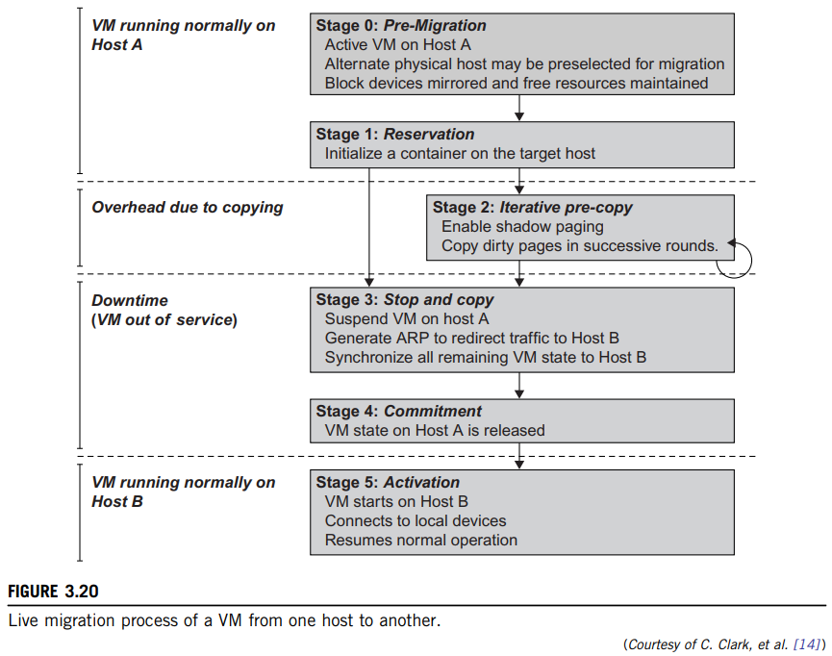

Slide 14
As shown in Figure 3.20, live migration of a VM consists of following six steps:
Steps 0 and 1: Start migration.
This step makes preparations for the migration, including determining the migrating VM and the destination host.
Although users could manually make a VM migrate to an appointed host, in most circumstances, the migration is automatically started by strategies such as load balancing and server consolidation.
Steps 2: Transfer memory.
Since the whole execution state of the VM is stored in memory, sending VM’s memory to destination node ensures continuity of service provided by the VM.
All of the memory data is transferred in the first round, and then the migration controller recopies the memory data which is changed in the last round.
These steps keep iterating until the dirty portion of the memory is small enough to handle the final copy.

Slide 15
Step 3: Suspend the VM and copy the last portion of the data.
The migrating VM’s execution is suspended when the last round’s memory data is transferred.
During this step, the VM is stopped and its applications will no longer run.
This “service unavailable” time is called the “downtime” of migration, which should be as short as possible so that it can be negligible to users.
Steps 4 and 5: Commit and activate the new host.
After all the needed data is copied, on the destination host, the VM reloads the states and recovers the execution of programs in it, and the service provided by this VM continues.
Then the network connection is redirected to the new VM and the dependency to the source host is cleared.
The whole migration process finishes by removing the original VM from the source host.

Slide 16
Figure 3.21 shows the effect on the data transmission rate (Mbit/second) of live migration of a VM from one host to another.
Before copying the VM with 512 KB files for 100 clients, the data throughput was 870 MB/second.
The first precopy takes 63 seconds, during which the rate is reduced to 765 MB/second.
Then the data rate reduces to 694 MB/second in 9.8 seconds for more iterations of the copying process.
The system experiences only 165 ms of downtime, before the VM is restored at the destination host.
This experimental result shows a very small migration overhead in live transfer of a VM between host nodes.

Slide 17
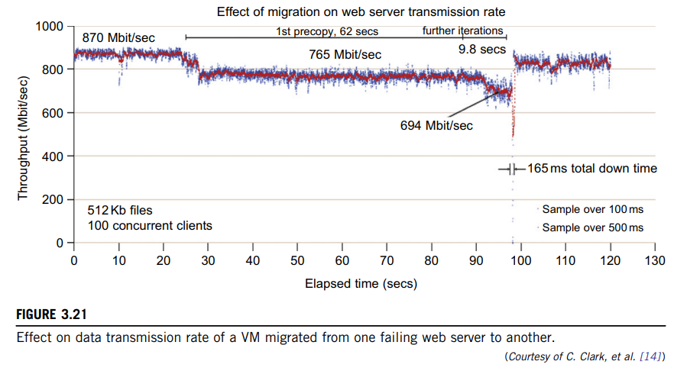

Slide 18
Migration of Memory, Files, and Network Resources
Since clusters have a high initial cost of ownership, including space, power conditioning, and cooling equipment, leasing or sharing access to a common cluster is an attractive solution when demands vary over time.
Shared clusters offer economies of scale and more effective utilization of resources by multiplexing.
When one system migrates to another physical node, we should consider the following issues:
Memory Migration
File System Migration
Network Migration
Live Migration of VM Using Xen

Slide 19
Memory Migration:
This is one of the most important aspects of VM migration.
Moving the memory instance of a VM from one physical host to another can be approached in any number of ways.
Memory migration can be in a range of hundreds of megabytes to a few gigabytes in a typical system today, and it needs to be done in an efficient manner.
The Internet Suspend-Resume (ISR) technique exploits temporal locality as memory states are likely to have considerable overlap in the suspended and the resumed instances of a VM.
Temporal locality refers to the fact that the memory states differ only by the amount of work done since a VM was last suspended before being initiated for migration.
To exploit temporal locality, each file in the file system is represented as a tree of small sub files.
The advantage of using a tree-based representation of files is that the caching ensures the transmission of only those files which have been changed.

Slide 20
File System Migration:
To support VM migration, a system must provide each VM with a consistent, location-independent view of the file system that is available on all hosts.
A simple way to achieve this is to provide each VM with its own virtual disk which the file system is mapped to and transport the contents of this virtual disk along with the other states of the VM.
However, due to the current trend of high capacity disks, migration of the contents of an entire disk over a network is not a viable solution.
Another way is to have a global file system across all machines where a VM could be located.
This way removes the need to copy files from one machine to another because all files are network accessible.

Slide 21
Network Migration:
To enable remote systems to locate and communicate with a VM, each VM must be assigned a virtual IP address known to other entities.
This address can be distinct from the IP address of the host machine where the VM is currently located.
Each VM can also have its own distinct virtual MAC address.
VMM maintains a mapping of the virtual IP and MAC addresses to their corresponding VMs.
If the source and destination machines of a VM migration are typically connected to a single switched LAN, an unsolicited ARP reply from the migrating host is provided advertising that the IP has moved to a new location.
Alternatively, on a switched network, the migrating OS can keep its original Ethernet MAC address and rely on the network switch to detect its move to a new port.

Slide 22
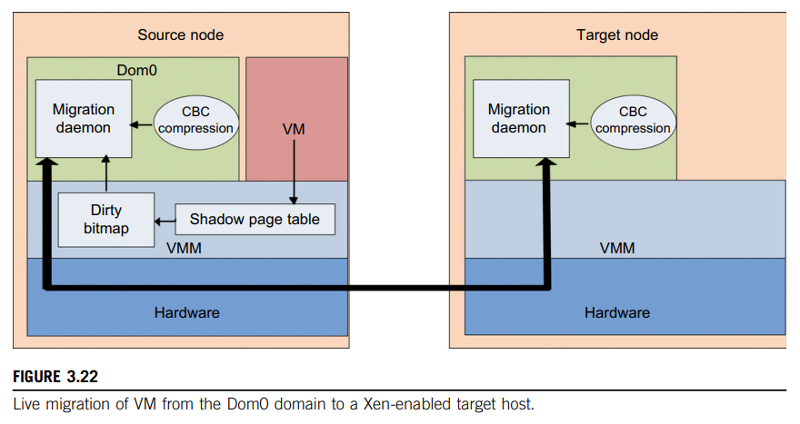
Live Migration of VM Using Xen:
In Section 3.2.1, we studied Xen as a VMM or hypervisor, which allows multiple commodity OSes to share x86 hardware in a safe and orderly fashion.
The following example explains how to perform live migration of a VM between two Xen-enabled host machines.
Domain 0 (or Dom0) performs tasks to create, terminate, or migrate to another host.
Xen uses a send/recv model to transfer states across VMs.

Slide 23
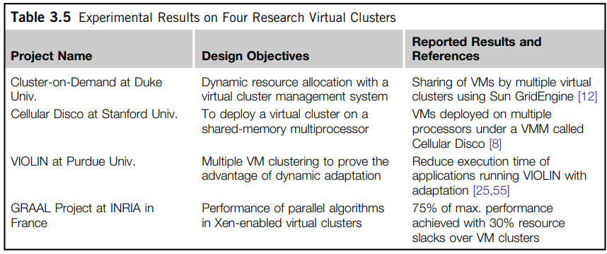
Dynamic Deployment of Virtual Clusters
Table 3.5 summarizes four virtual cluster research projects. We briefly introduce them here just to identify their design objectives and reported results.

